Slide 1

Cloud Computing
What is Cloud Computing ?
Types of Cloud Computing ?
Advantages of Cloud Computing ?
IaaS Offerings from Oracle
Why Oracle IaaS?
PaaS Offerings from Oracle
Why Oracle PaaS?
SaaS Offerings from Oracle
Why Oracle SaaS?

Slide 2
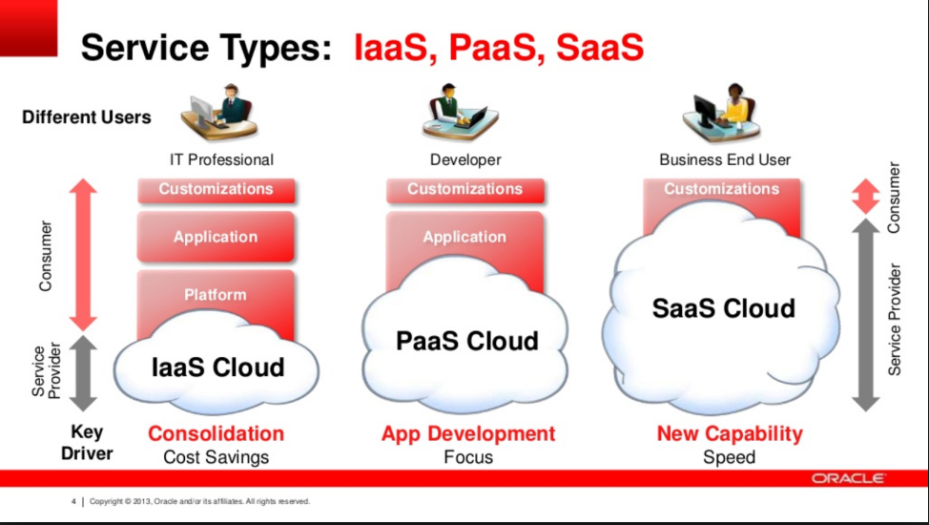
Types of Cloud Services
Based on Service Offerings
IaaS (Infrastructure-as-a-Service)
PaaS (Platform-as-a-Service)
SaaS (Software-as-a-Service)

Slide 3
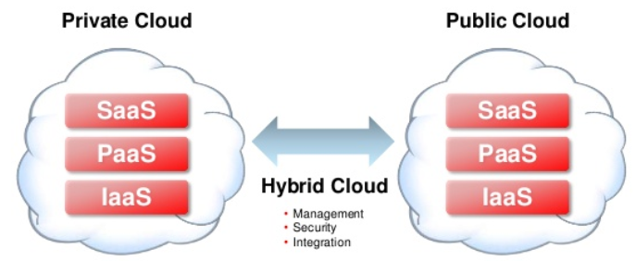
Types of Cloud Services
Based on Deployment Model
Public
Private
Hybrid

Slide 4
Advantages of Cloud Computing:
IaaS
No need to invest in IT infrastructure or Resources
Highest level of flexibility and control to organize Infrastructure Resources
Scale up or down Infrastructure as and when required
Pay as Per Use.
PaaS
Focus more on Application Development
Easy Deployment & Monitoring of Applications
No worries to upgrade resources, capacity of the underlying infrastructure.
Reduced Cost
SaaS:
Access to wide variety of complete packaged applications with customizations feature.
Easily Accessible from anywhere through internet
No risk of Data Loss
No burden of maintenance and support

Slide 5
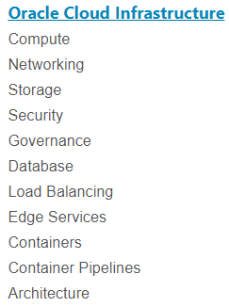
Oracle IaaS Offerings:

Slide 6
Why Oracle IaaS?
Performance, Control, Governance of Enterprise Data Centers
Leading Hardware for Modern Architecture
Capable of running multi-tiered enterprise applications
Enterprise level High Availability
Non-Blocking & High-Performance Workloads
Maximize Flexibility and Security
Serverless & Container-Based Architectures

Slide 7
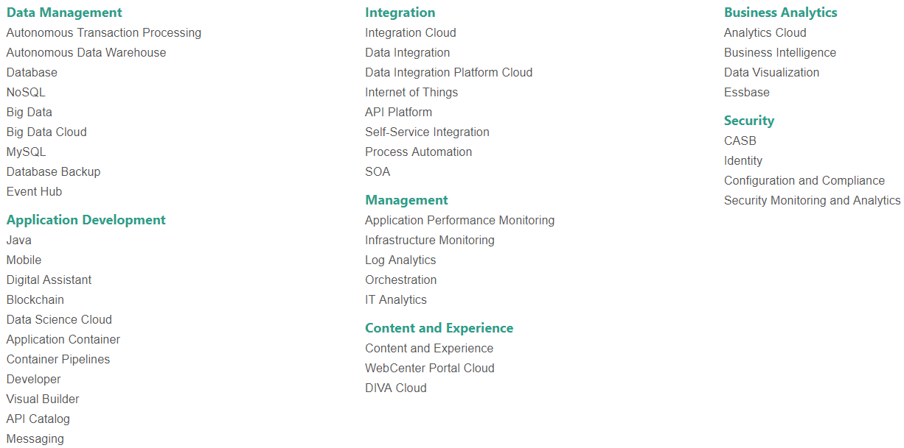
Oracle PaaS Offerings:

Slide 8
Why Oracle PaaS?
Most Comprehensive & Integrated
Open & Standards Based
Lower Cost of Ownership
Easily Integrate & Extend SaaS
Highest Security, Scalability & Performance
Deployment Choice

Slide 9
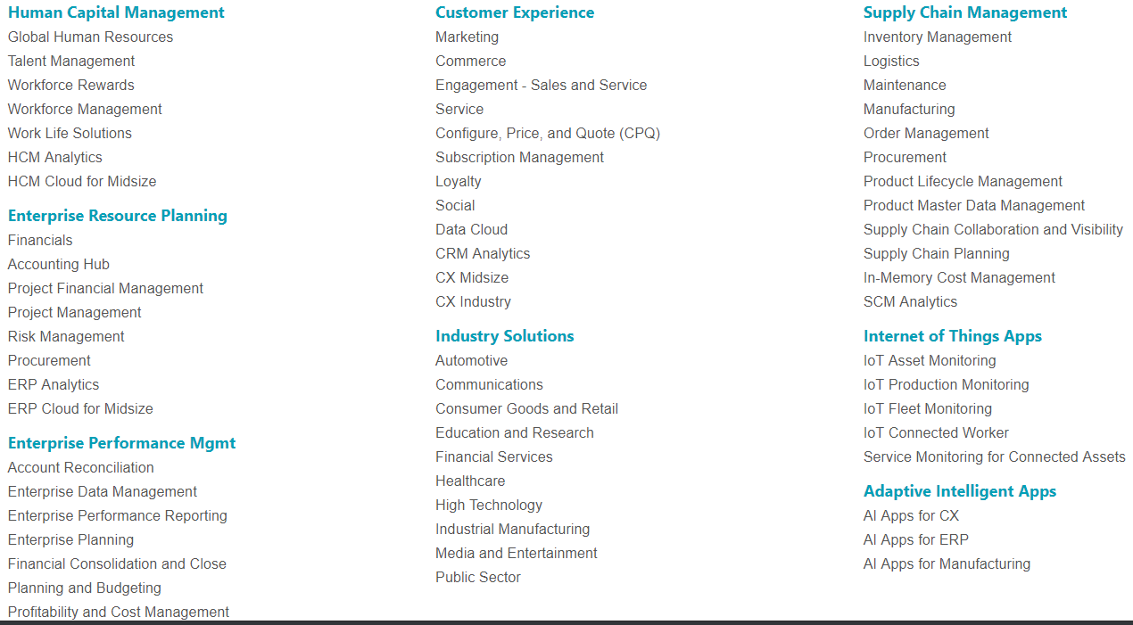
Oracle SaaS Offerings:

Slide 10
Why Oracle SaaS?
Complete, Future-proof & Trusted Packaged Applications
Enables Modern Business Transformation
Wide Range of solutions and standardized business processes
Leverages Modern Technology Stack
AI enabled applications
Reduced Cost
Exceed Expectations

